Slide 1
Sequential Logic
Chapter 5b
Imran Siddiqi
imran.siddiqi@mcs.edu.pk
Computer Science Department
College of Telecommunication Engineering
National University of Sciences and Technology

Slide 2
Contents
SR Latch with Control Input
D Latch
Latches vs Flip Flops
D Flip Flop
JK Flip Flop
T Flip Flop
Characteristic Equations and Tables

Slide 3
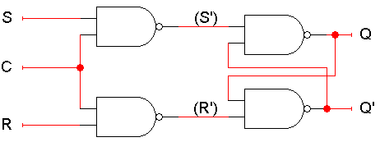
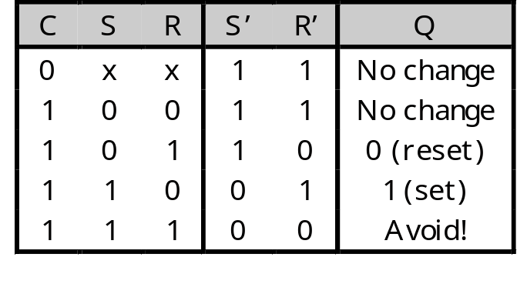
SR Latch with Control Input
Notice the hierarchical design!
  The dotted blue box is the S’R’ latch from the previous slide.
  The additional NAND gates are simply used to generate the correct inputs for the S’R’ latch.
The control input acts just like an enable.

Slide 4
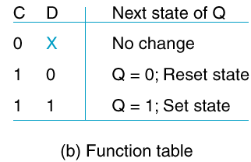
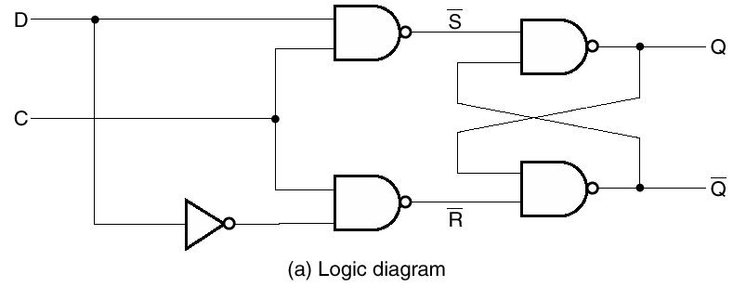
D Latch
No illegal state

Slide 5
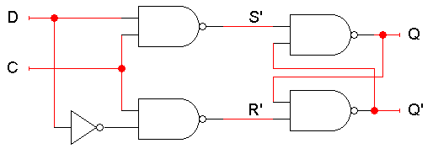
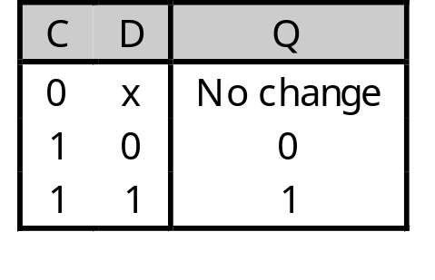
D Latch
A D latch is based on an S’R’ latch. The additional gates generate the S’ and R’ signals, based on inputs D (“data”) and C (“control”).
  When C = 0, S’ and R’ are both 1, so the state Q does not change.
  When C = 1, the latch output Q will equal the input D.
No more messing with one input for set and another input for reset!

Slide 6
D Latch
D Latch is also called transparent latch
Whatever is on D is passed onto Q

Slide 7
D Latch
Symbol
D
Q
C | D | Q | Q
0 | X | NC | NC
1 | 0 | 0 | 1
1 | 1 | 1 | 0
C
Q
NC: No Change

Slide 8
Summary
A sequential circuit has memory. It may respond differently to the same inputs, depending on its current state.
Memories can be created by making circuits with feedback.
  Latches are the simplest memory units, storing individual bits.
  It’s difficult to control the timing of latches in a larger circuit.
Next, we’ll improve upon latches with flip-flops, which change state only at well-defined times. We will then use flip-flops to build all of our sequential circuits.

Slide 9
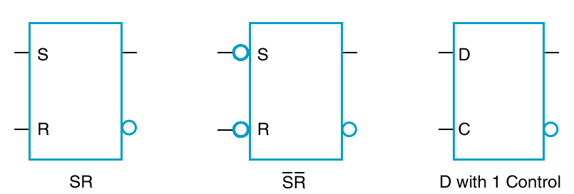
Standard Symbols - Latches
SR
S’R’
D with control
Circle at input indicates negation

Slide 10

Latches vs Flip Flops
Latch = level-sensitive device
  State changes with input when enabled (e.g. clock = 1)
  Holds last input value when disabled (when clock = 0)
Flip-flop = edge-triggered device
  State of flip-flop can only change during clock transition
  Example: Flip-flops change on rising/falling edge of clock

Slide 11
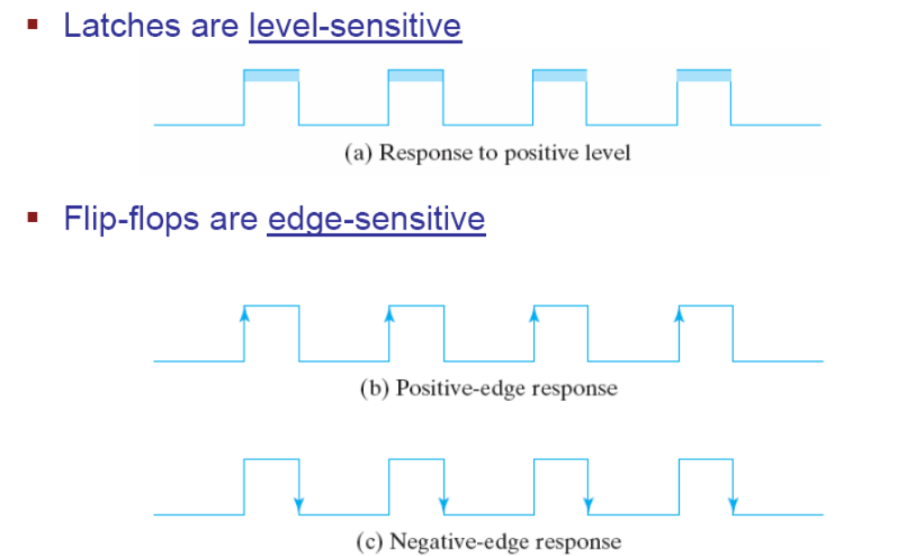
Level Sensitive vs Edge Triggered

Slide 12

Flip Flops
D Latch – Data is stored when the clock is high
How can we build a flip flop that stores on edge transitions?

Slide 13
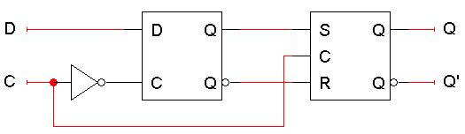
D Flip Flop – Master Slave
The flip-flop inputs are C and D, and the outputs are Q and Q’.
The D latch on the left is the master, while the SR latch on the right is called the slave.

Slide 14
D Flip Flop
The flip-flop input D is connected directly to the master latch.
The master latch output goes to the slave.
The flip-flop outputs come directly from the slave latch.

Slide 15
D flip-flops when C=0
The D flip-flop’s control input C enables either the D latch or the SR latch, but not both.
When C = 0:
  The master latch is enabled, and it monitors the input D. Whenever D changes, the master’s output changes too.
  The slave is disabled, so the D latch output has no effect on it. Thus, the slave just maintains the flip-flop’s current state.

Slide 16
D flip-flops when C=1
As soon as C becomes 1, (i.e. on the rising edge of the clock)
  The master is disabled. Its output will be the last D input value seen just before C became 1.
  Any subsequent changes to the D input while C = 1 have no effect on the master latch, which is now disabled.
  The slave latch is enabled. Its state changes to reflect the master’s output, which again is the D input value from right when C became 1.

Slide 17
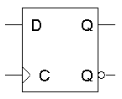
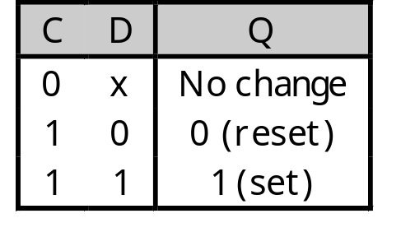
Positive Edge Triggering
This is called a positive edge-triggered flip-flop.
  The flip-flop output Q changes only after the positive edge of C.
  The change is based on the flip-flop input values that were present right at the positive edge of the clock signal.
The D flip-flop’s behavior is similar to that of a D latch except for the positive edge-triggered nature, which is not explicit in this table.

Slide 18
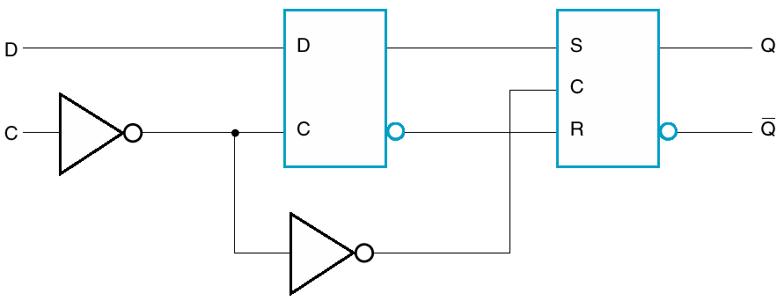
D Flip Flop
Is this +ve or –ve edge-triggered?

Slide 19
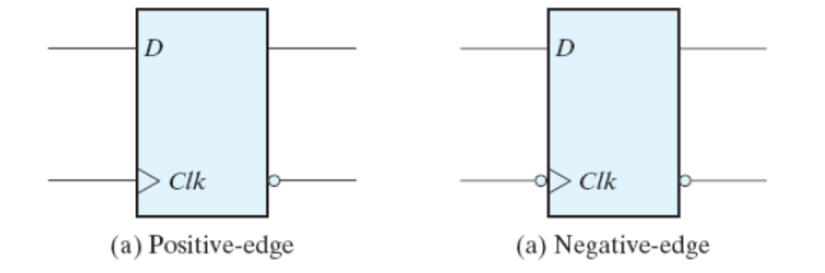
Flip Flop Symbols
Triangle indicates clock
Edge trigger:
  No bubble at clock: positive edge triggered
  Bubble at clock: negative edge triggered

Slide 20
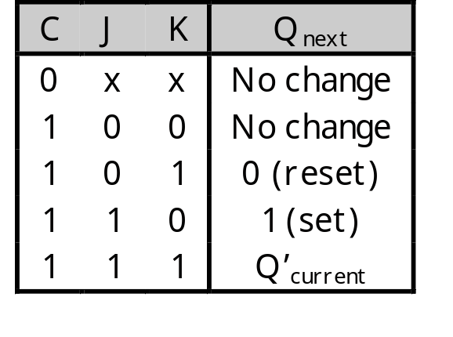
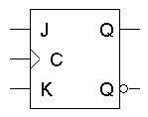
Flip Flop Variations
A JK flip-flop has inputs that act like S and R, but the inputs JK=11 are used to complement the flip-flop’s current state

Slide 21
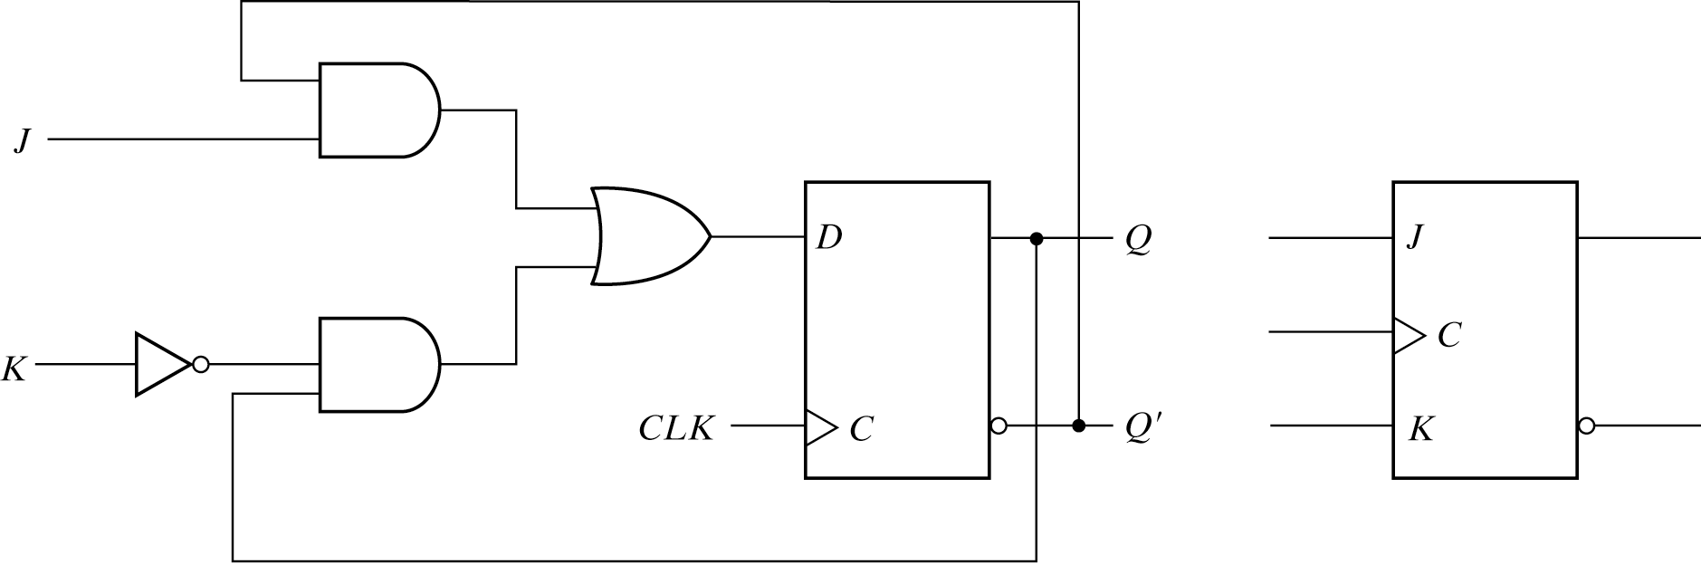
JK Flip Flop
Created from D flip flop
D = JQ’+K’Q

Slide 22
JK Flip Flop
Created from D flip flop
D = JQ’+K’Q
J=1 & K=0
J=0 & K=1
J=1 & K=1
J=0 & K=0
D = Q’+Q = 1
Flip flop is SET
D = 0+0 = 0
Flip flop is RESET
D = Q’+0 = Q’
Output is Complemented
D = Q+0 = Q
Output unchanged

Slide 23
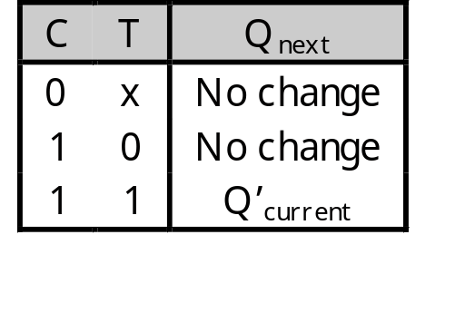
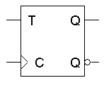
T (Toggle) Flip Flop
A T (toggle) flip-flop can only maintain or complement its current state.

Slide 24
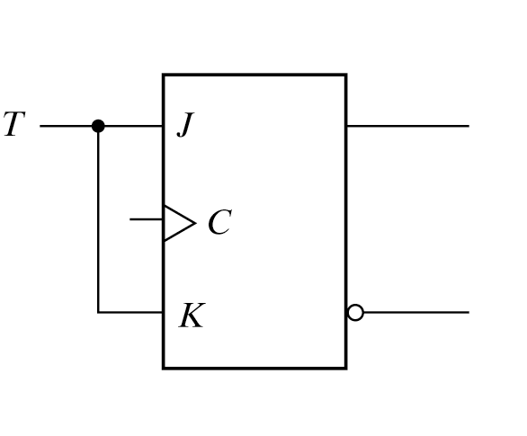
T (Toggle) Flip Flop
Created from JK flip flop

Slide 25
T (Toggle) Flip Flop
Created from JK flip flop
When T = 0, J=0 & K=0
When T = 1, J=1 & K=1
Output is unchanged
Output is complemented

Slide 26
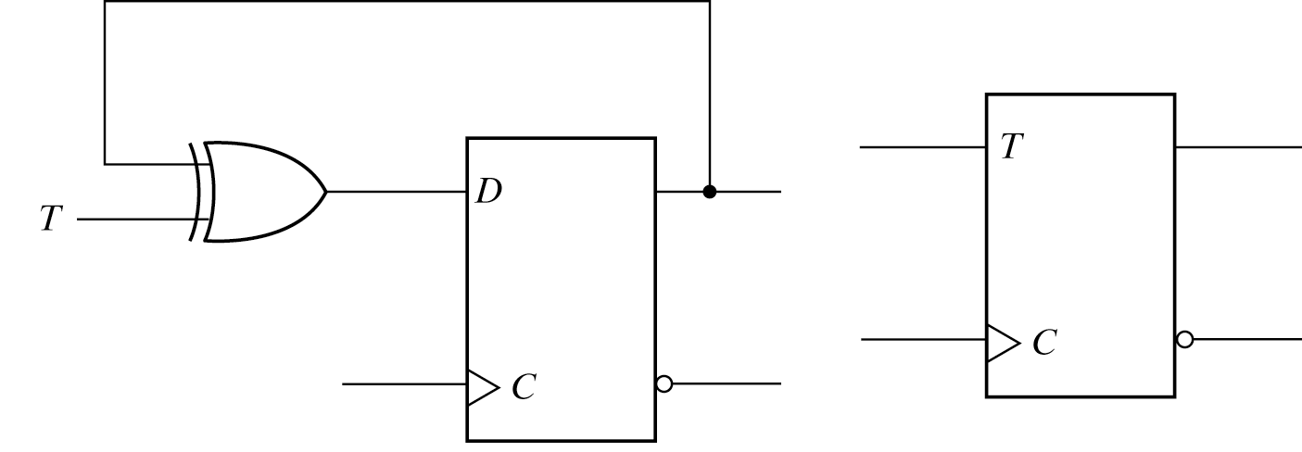
T (Toggle) Flip Flop
Created from D flip flop
D = TQ’+T’Q
When T = 0, D=Q
When T = 1, D=Q’
Output is unchanged
Output is complemented

Slide 27
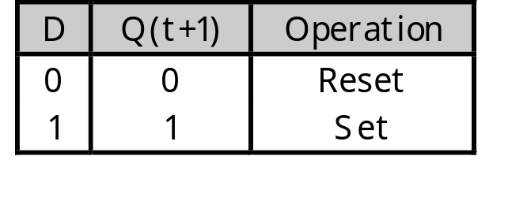
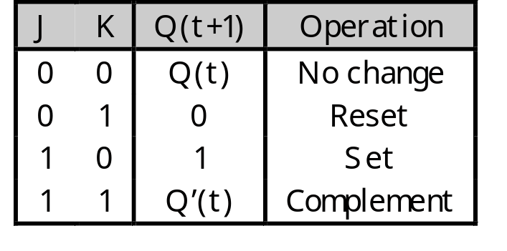
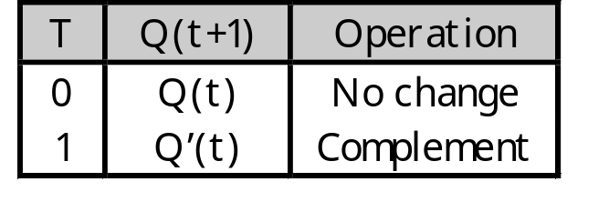
Characteristic Tables
The tables that we’ve made so far are called characteristic tables.
  They show the next state Q(t+1) in terms of the current state Q(t) and the inputs.
  For simplicity, the control input C is not usually listed.
  Again, these tables don’t indicate the positive edge-triggered behavior of the flip-flops that we’ll be using.

Slide 28
Characteristic Equations
We can also write characteristic equations, where the next state Q(t+1) is defined in terms of the current state Q(t) and inputs.
Q(t+1) = D
Q(t+1) = K’Q(t) + JQ’(t)
Q(t+1) = T’Q(t) + TQ’(t)
= T ⊕ Q(t)

Slide 29
State Diagrams
To describe combinational circuits, we used Boolean expressions and truth tables. With sequential circuits, we can still use expression and tables, but we can also use another form called a state diagram.
The following state diagram represents a D flip-flop.
We draw one node for each state that the circuit can be in. Flip-flops have only two states: Q=0 and Q=1.
Arrows between nodes are labeled with input values and indicate how the circuit changes states
D=0
D=1
D=1
Q=0
Q=1
D=0

Slide 30
References
Chapter 6 – Digital Design Morris Mano
Digital Logic and Computer Design – M. Singh, University of North Carolina
Latches & Flip-flops - Bobby Nazief
Material in these slides has been taken from, the following resources

